Slide 1

Leveraging Traefik for a Highly Available Ingress Controller
on Docker Enterprise
2/6/2020
Andy Clemenko
andy@stackrox.com
@clemenko

Slide 2
https://andyc.info/traefik
2/6/2020
Andy Clemenko
andy@stackrox.com
@clemenko

Slide 3

Who am I?
Former DoD Contractor
Docker Senior Solutions Architect/Principal Solutions Engineer
Drinking Container Koolaid for almost 6 years
Loving Traefik for about 4 years
Run Traefik with Docker Compose Personally
Recommend Traefik on K8s Professionally

Slide 4

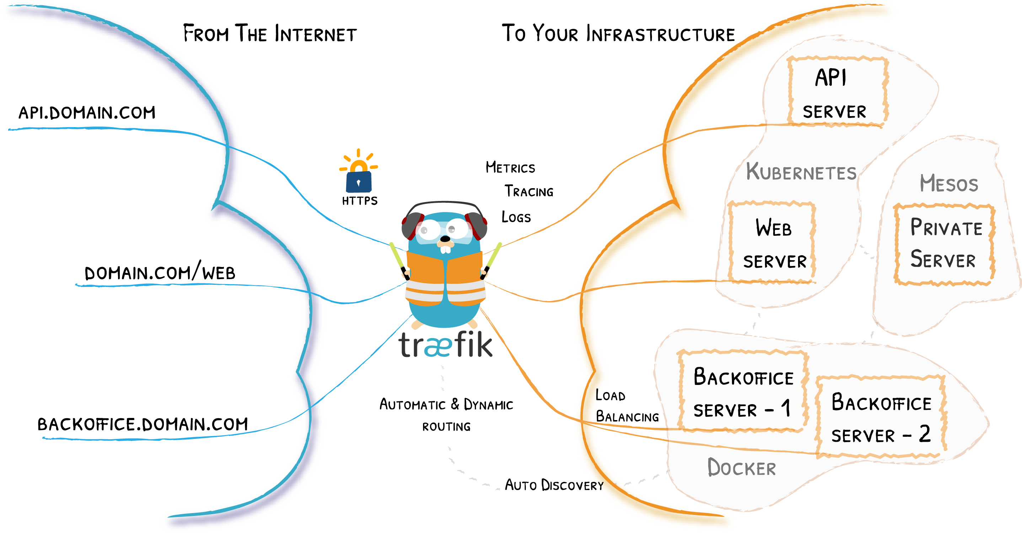
What and Why Traefik?
Ingress Controller
Dynamic Configuration
Empowering Developers
Declarative
Look Cool!

Slide 5
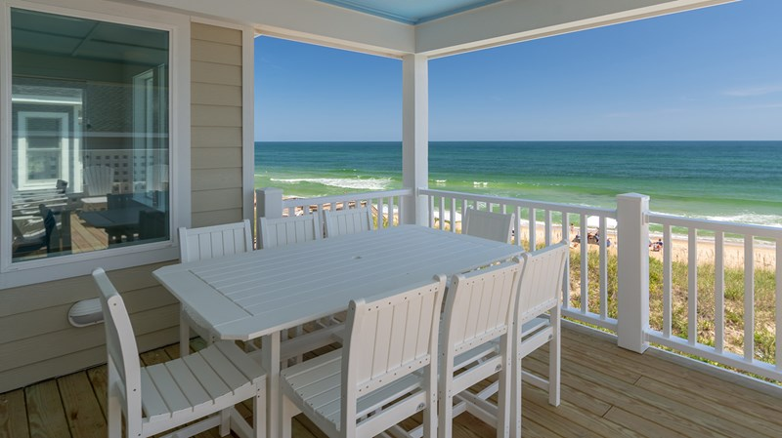
Why High Availability (HA)?
Eliminate Single Point of Failure (SPOF)
Resilient for Upgrades
Take Time Off
Look Cool!

Slide 6

What Are We Building?
External Load Balancer - DigitalOcean LB
Six Node Docker Enterprise Cluster - Kubernetes 1.14
Three HA K8s Master Nodes (4vcpu-8gb)
Three Worker Nodes with labels (4vcpu-8gb)
Traefik Pinned to nodes with Labels
NodePort or LoadBalancer
*.dockr.life
K8s Masters
K8s Workers

Slide 7
Network Path
Wild Card DNS
Load Balancer
Worker Node
Traefik service/pod
App service/pod
*.dockr.life
K8s Workers

Slide 8

Demo
https://andyc.info/traefik

Slide 9

Future?
Where to deploy?
Top of Rack
AZ?
TLS - Considerations - https://docs.traefik.io/user-guides/crd-acme/
Persistent Storage
Let’s Encrypt
Traefik Enterprise Edition

Slide 10
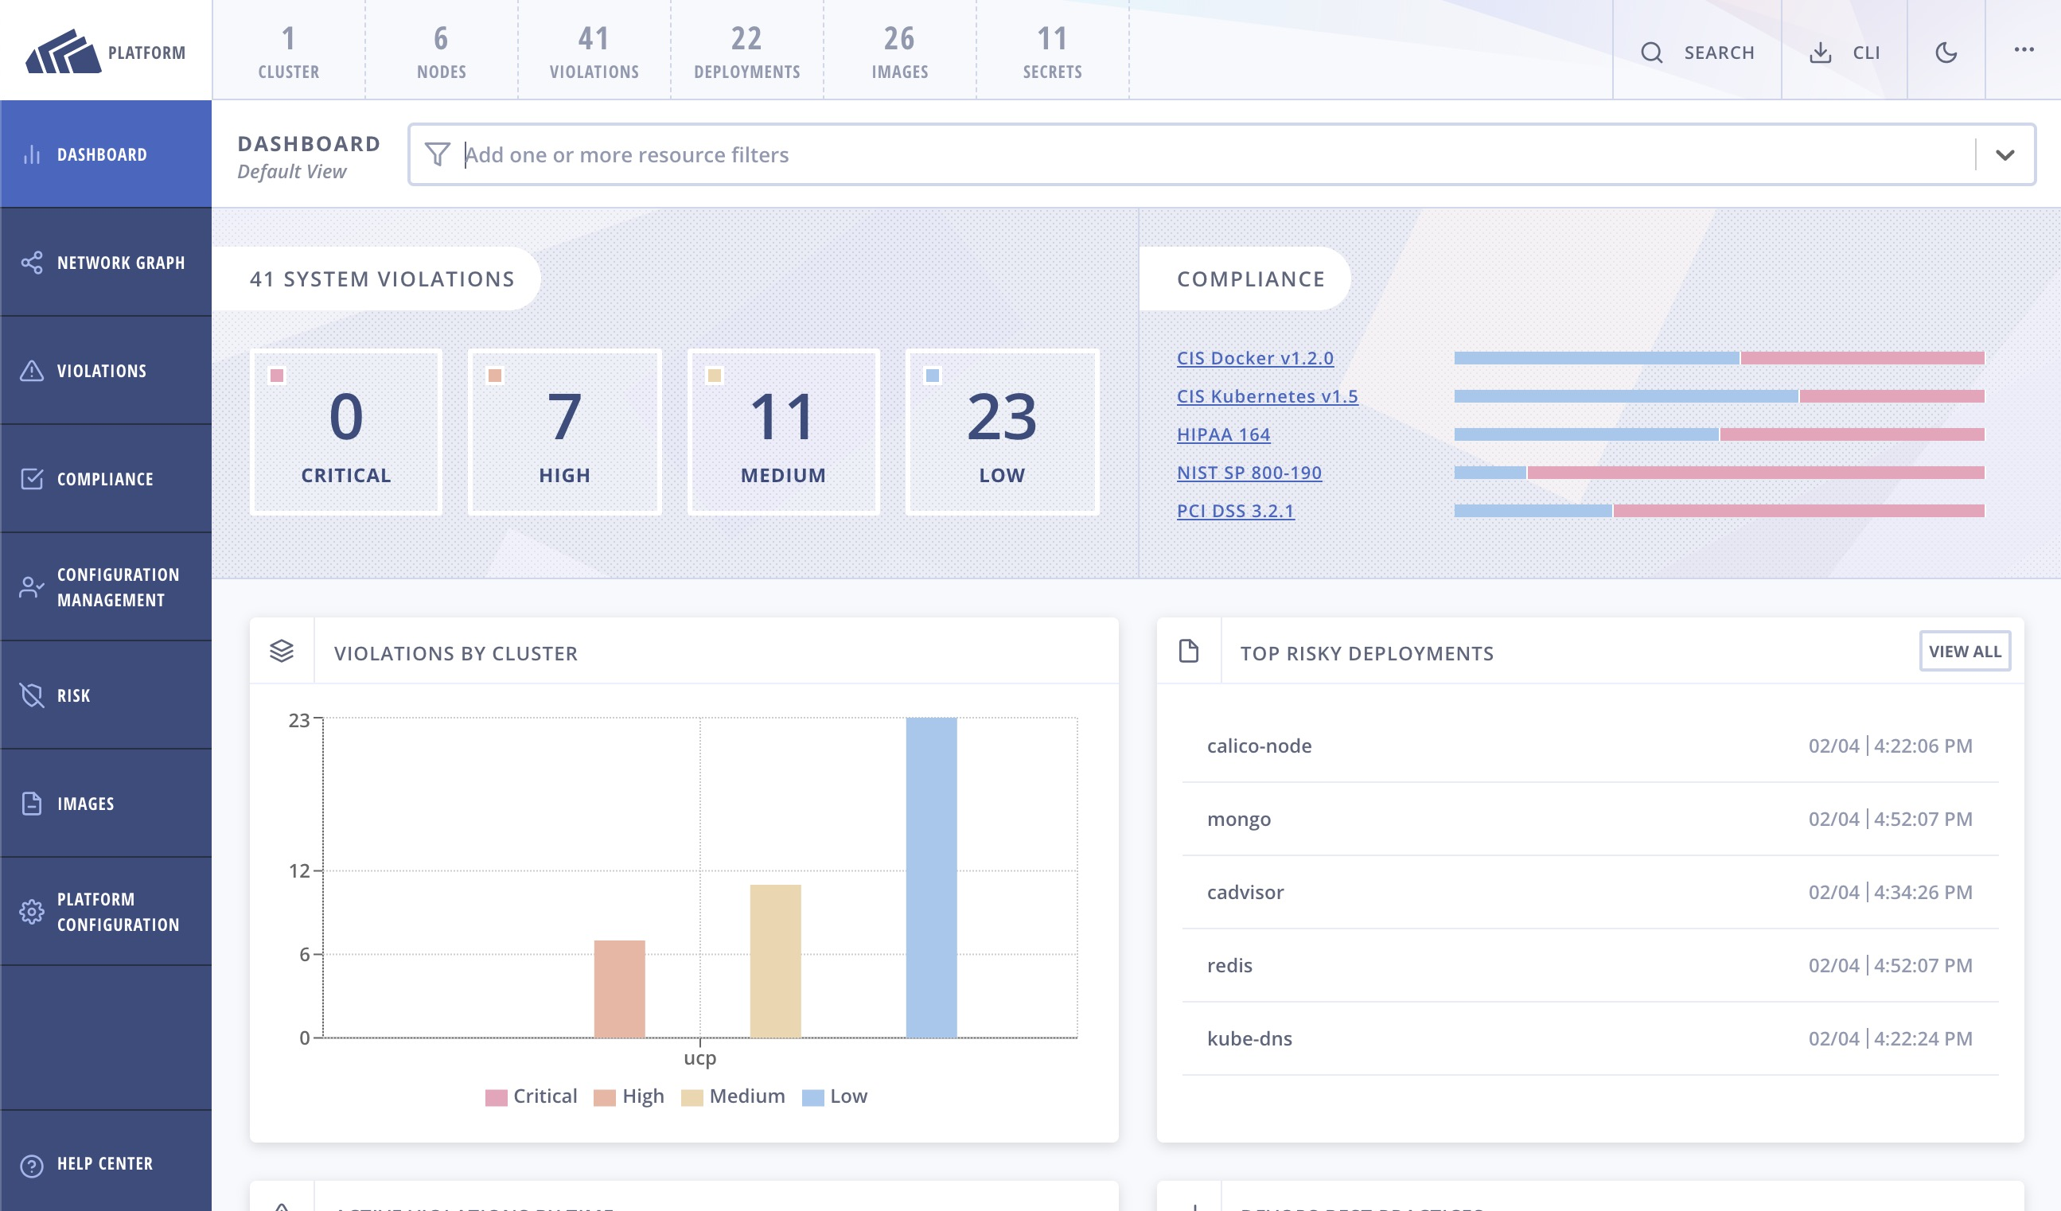
StackRox
Actionable advise from Security Observability
Kubernetes Native
Security for full lifecycle
Build
Deploy
Runtime

Slide 11

Questions?
Thanks for watching!
@clemenko / andy@stackrox.com
https://andyc.info/traefik
https://docs.traefik.io

